Slide 1
UMW Room Reservation Software System
Brian Walsh
Bryan Moore
Michael Halo

Slide 2
The Client and Requirements
The University of Mary Washington needs a software system to allow faculty, staff, and students to reserve rooms
Anyone needs to be able to view a calendar that shows reservations’ times, who made it, and the location
Users need to be able to search for a room based on criteria such as capacity, building, date/time, equipment, and seating
Users should be shown a list of available room options and allowed to reserve a room from the list
Information must be stored between sessions

Slide 3
Features Available to Guests
Guests are allowed to sign in, sign up, or view the weeks schedule.
If they choose to view the week’s schedule, a window appears with a button for each day of the week. Upon choosing a button, the day’s reservations are printed out.
If they choose to sign up, they choose an username and password, which are then stored.
If they choose to sign in, they enter their username and password and are taken to the next window

Slide 4
Features Available to Users
Users can choose to make a reservation, view the weeks schedule, or view their reservations.
If they choose to make a reservation, they are taken to a window where they choose criteria they would like the room to match. Then, the rooms that match their criteria are shown to them, they choose one and enter a time, and press the make reservation button.
If they choose to view the week’s schedule, a window appears with a list of the reservations sorted by soonest first.
If they choose to view their reservations, all of the reservations they have made are shown to them.

Slide 5
Features Available to Admins
Admins are granted all the same features as regular users, with the addition of removing users’ accounts and modifying reservations.
If they choose to delete users’ accounts they are taken to a list of users, where they can select one and delete it
If they choose to modify a reservation they are taken to a list of reservations, where they can select one and change aspects of the reservation through the same page as making a new reservation

Slide 6
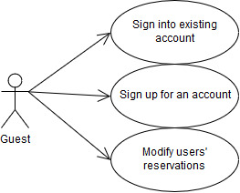
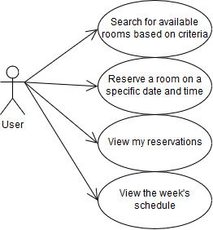
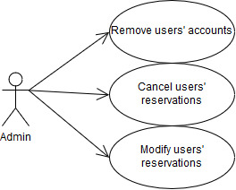
Use Cases

Slide 7
Program Design
MainMenu allows the user to choose what they would like to do
SignIn is the first window that pops up, and allows the users to sign in, sign up, or view the calendar
MakeReserv handles most of the reservation process
CalendarGUI handles displaying the reservations
ChangeRoom, ChangeScreen allow changes to reservations
AdminChange and AdminDelete allow Administrators to modify reservations and delete users
MakeReserv handles most of the reservation process

Slide 8
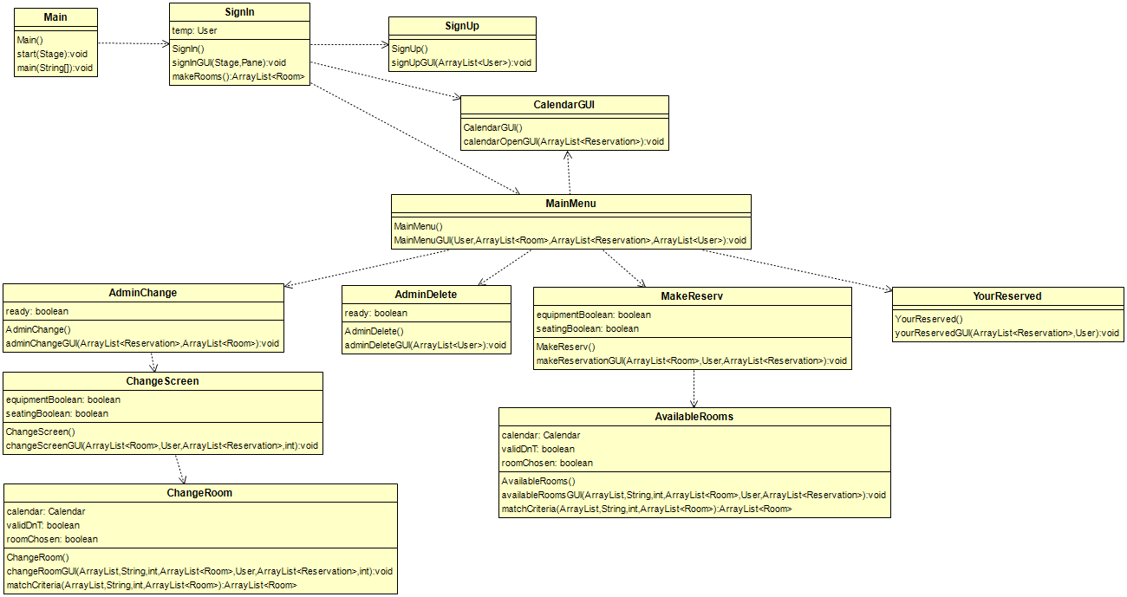
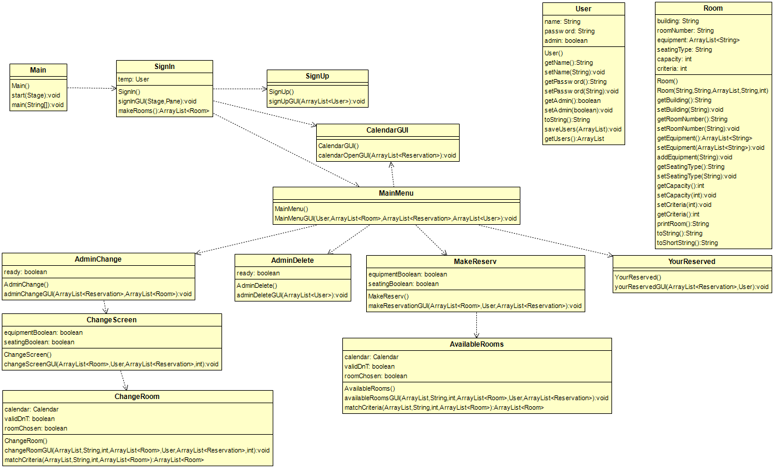
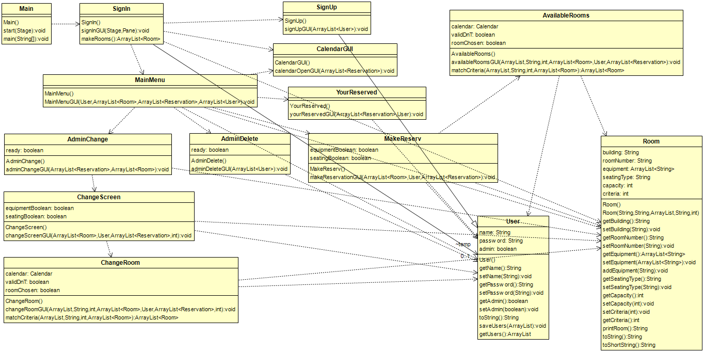
Class Diagram
I will build a class diagram after I see the final code

Slide 9
Software Demonstration

Slide 10
Project Demonstration

